Slide 1
ORIENTATION-NSS
29.1.2021

Slide 2



NATIONAL SERVICE SCHEME
SHRI SHIKSHAYATAN COLLEGE

Slide 3
AIM
NOT ME BUT YOU
PERSONALITY DEVELOPMENT PROGRAMME
TO BRIDGE THE GAP BETWEEN INSTITUTION AND COMMUNITY
FAMILIARISE WITH THE STRUGGLE AND CONSTRAINTS OF PEOPLE

Slide 4
OBJECTIVES
UNDERSTAND THE COMMUNITY IN WHICH THEY WORK
UNDERSTAND THEMSELVES IN RELATION TO THEIR COMMUNITY
DEVELOP AMONG THEMSELVES A SENSE OF SOCIAL AND CIVIC RESPONSIBILITY
UTILISE THEIR KNOWLEDGE IN FINDING PRACTICAL SOLUTIONS TO INDIVIDUAL AND COMMUNITY PROBLEMS
DEVELOP COMPETENCE REQUIRED FOR GROUP-LIVING AND SHARING OF RESPONSIBILITIES
ACQUIRE LEADERSHIP QUALITIES AND DEMOCRATIC ATTITUDES
PRACTISE NATIONAL INTEGRATION AND SOCIAL HARMONY

Slide 5
BROAD THEME OF ACTIVITIES
ENVIRONMENTAL ISSUES
HEALTH ISSUES
EDUCATION ISSUES
GENDER ISSUES
NSS SPECIAL CAMP (7 DAYS)

Slide 6
1. WE WORK WITH NGOS ON A REGULAR BASIS (WEEKLY)
2. AWARENESS PROGRAMMES
3.VISIT TO INSTITUTIONS
4. BLOOD DONATION DRIVE
5. SPECIAL CAMP
Little Sisters of the Poor
Society for Indian Children's Welfare
UMEED
BLOODCONNECT

Slide 7
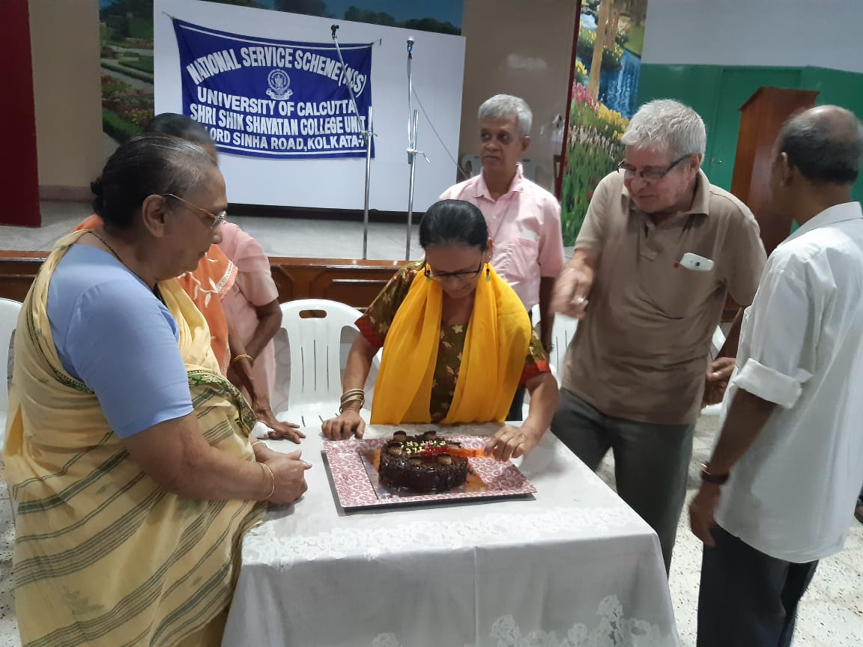
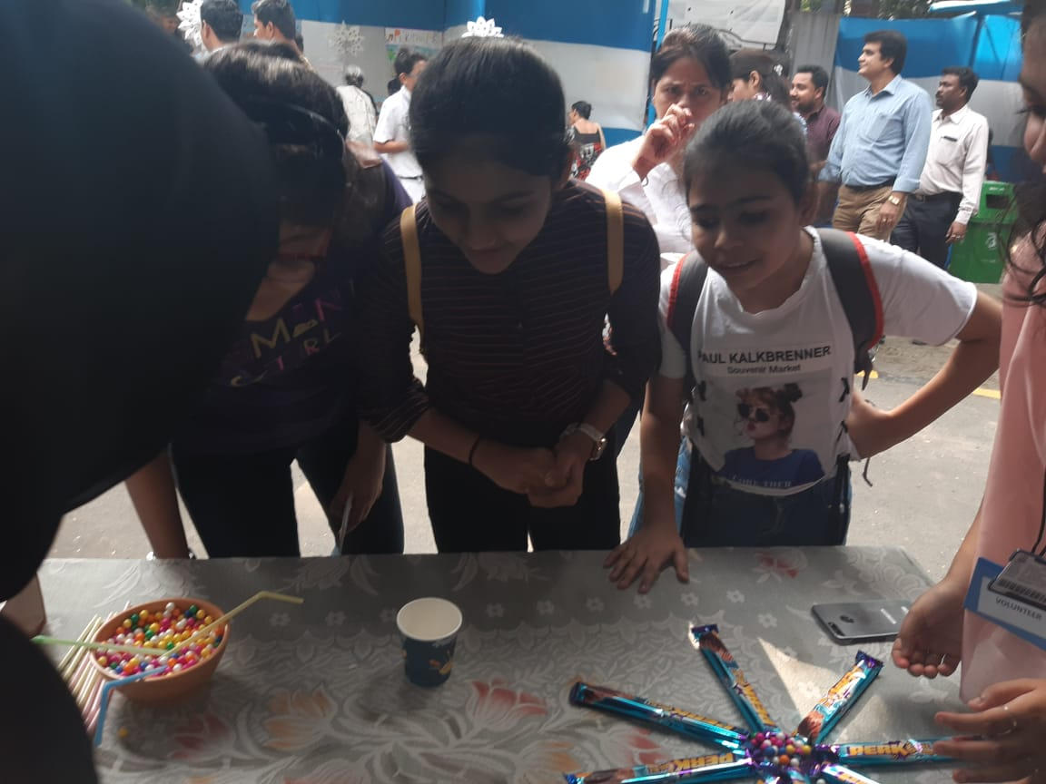
Little Sisters of the Poor

Slide 8
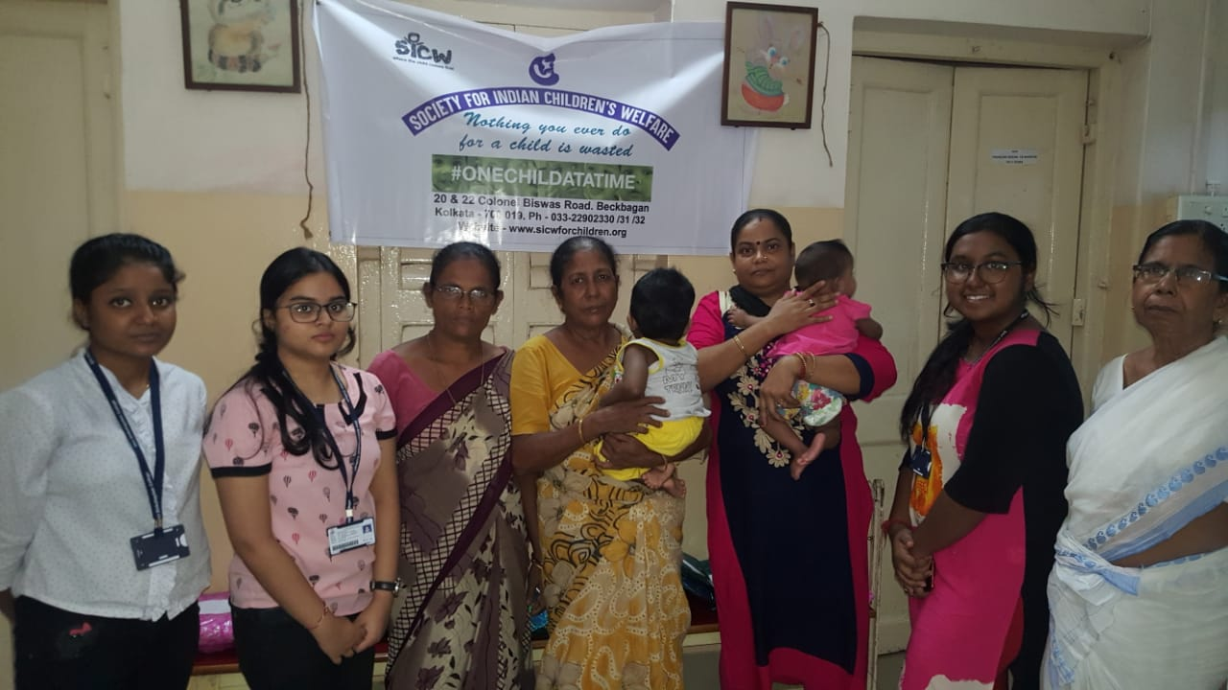
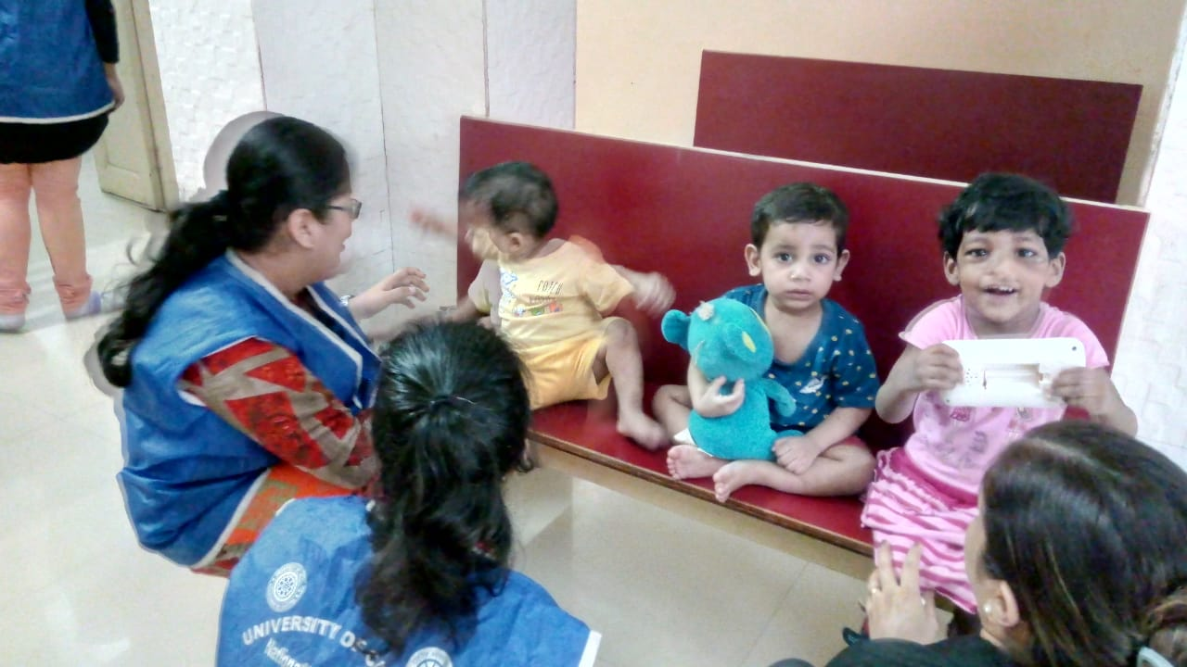
Society for Indian Children's Welfare

Slide 9
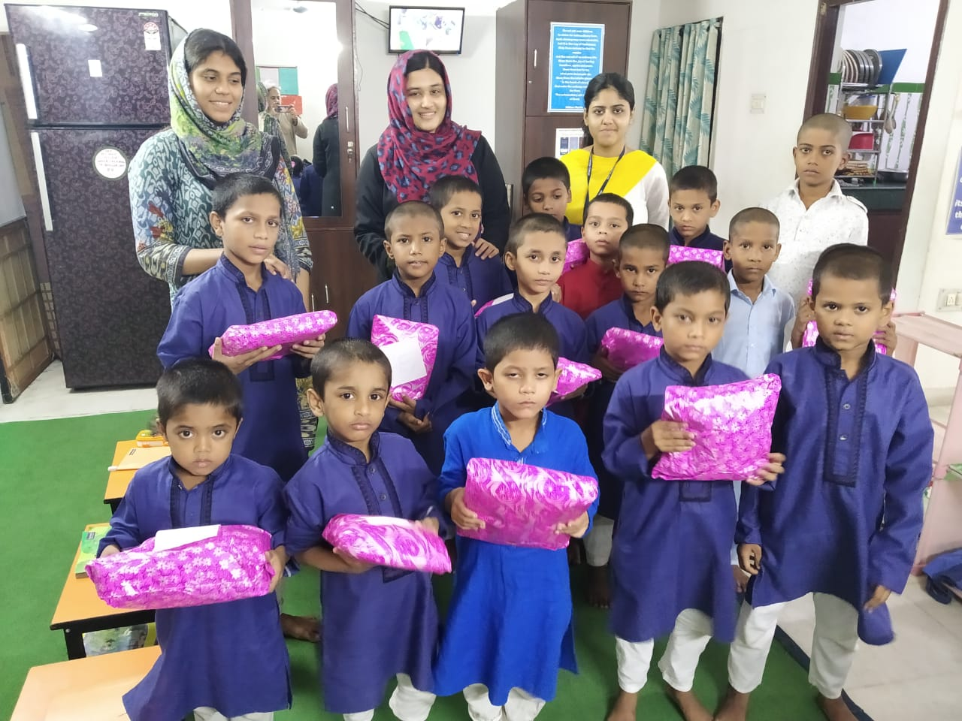
UMEED

Slide 10
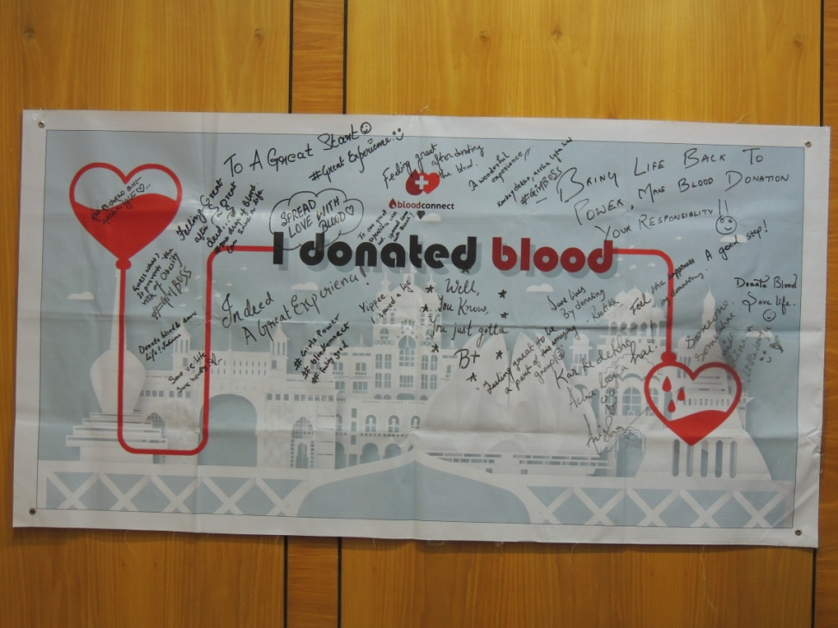
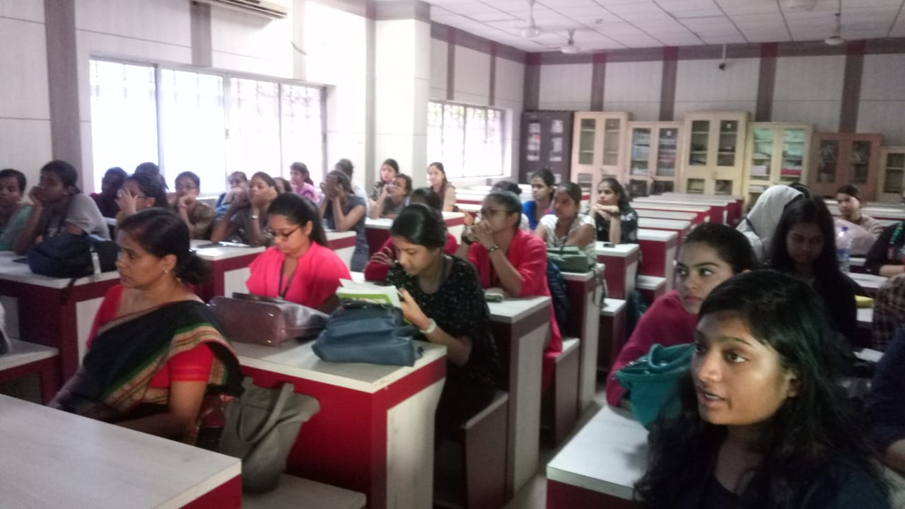
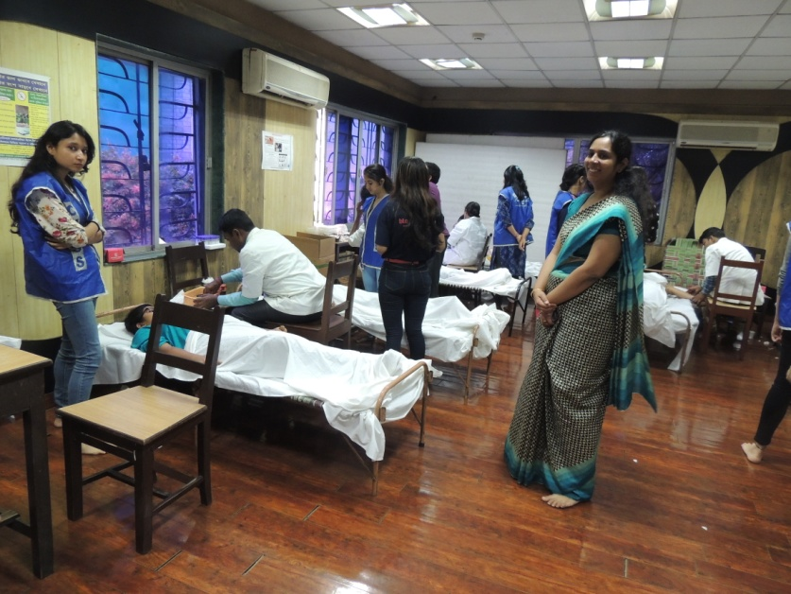
BLOODCONNECT

Slide 11
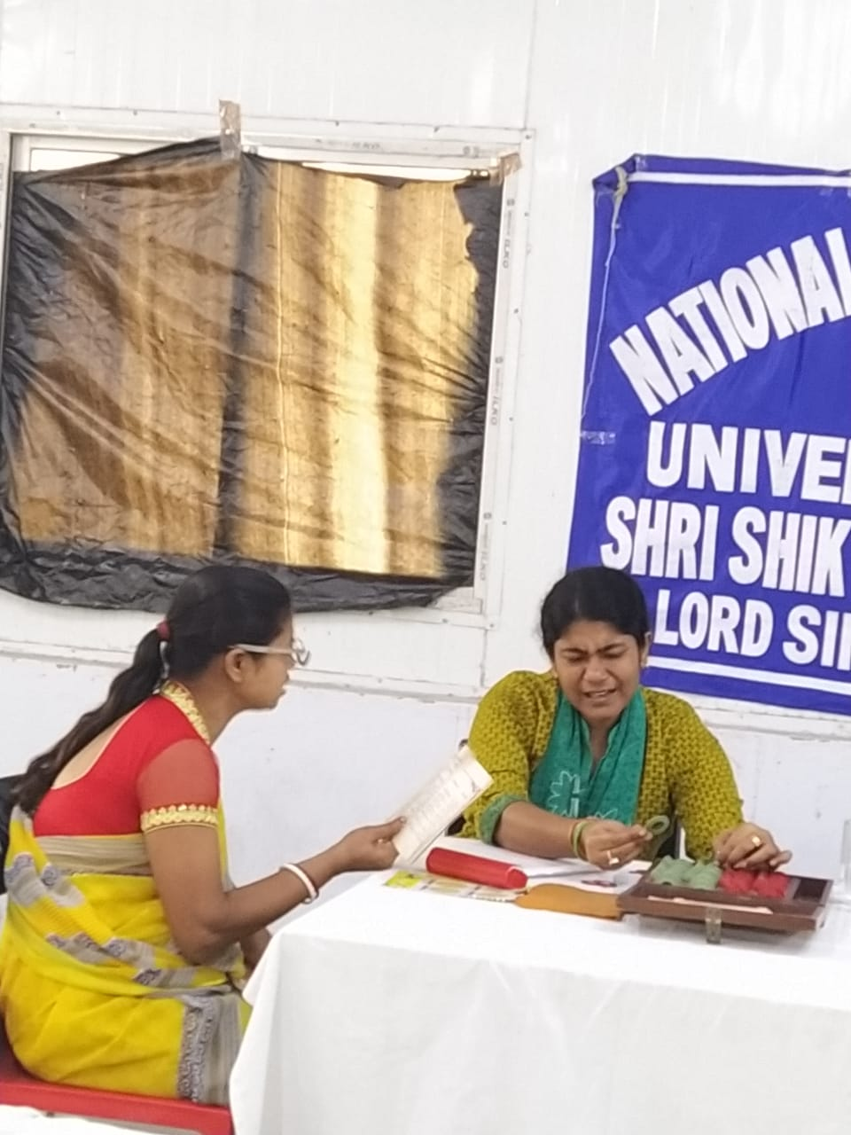
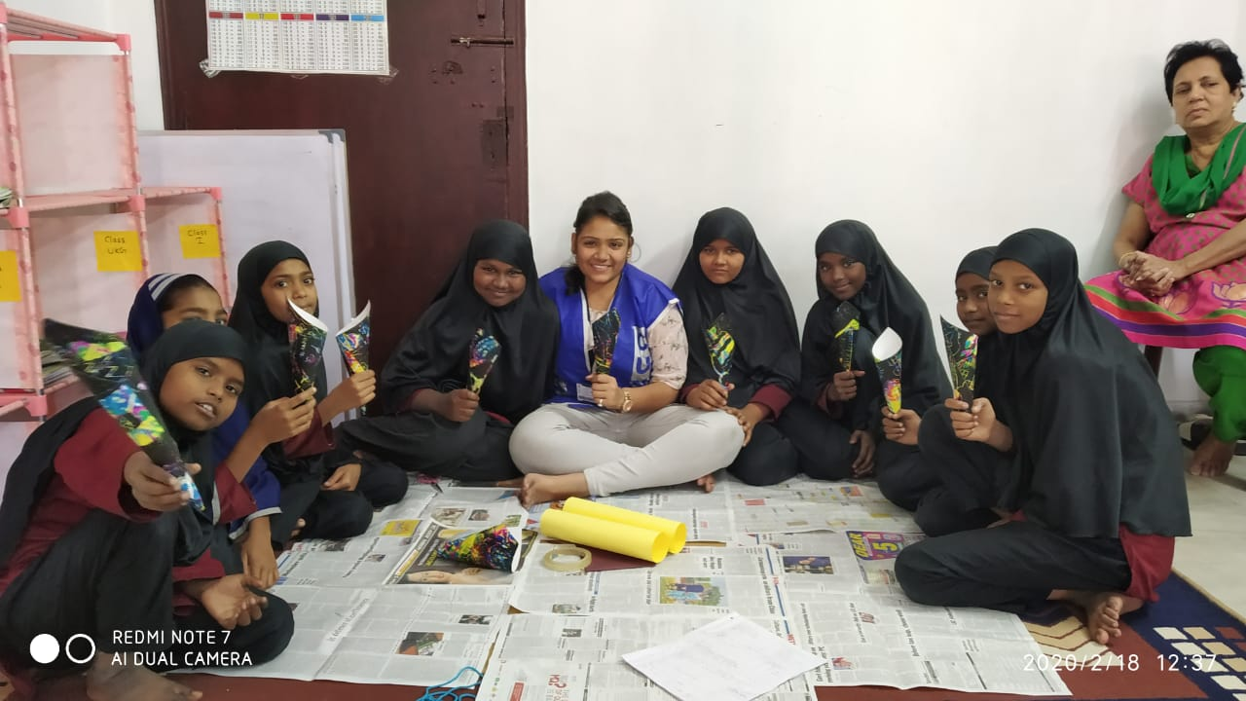
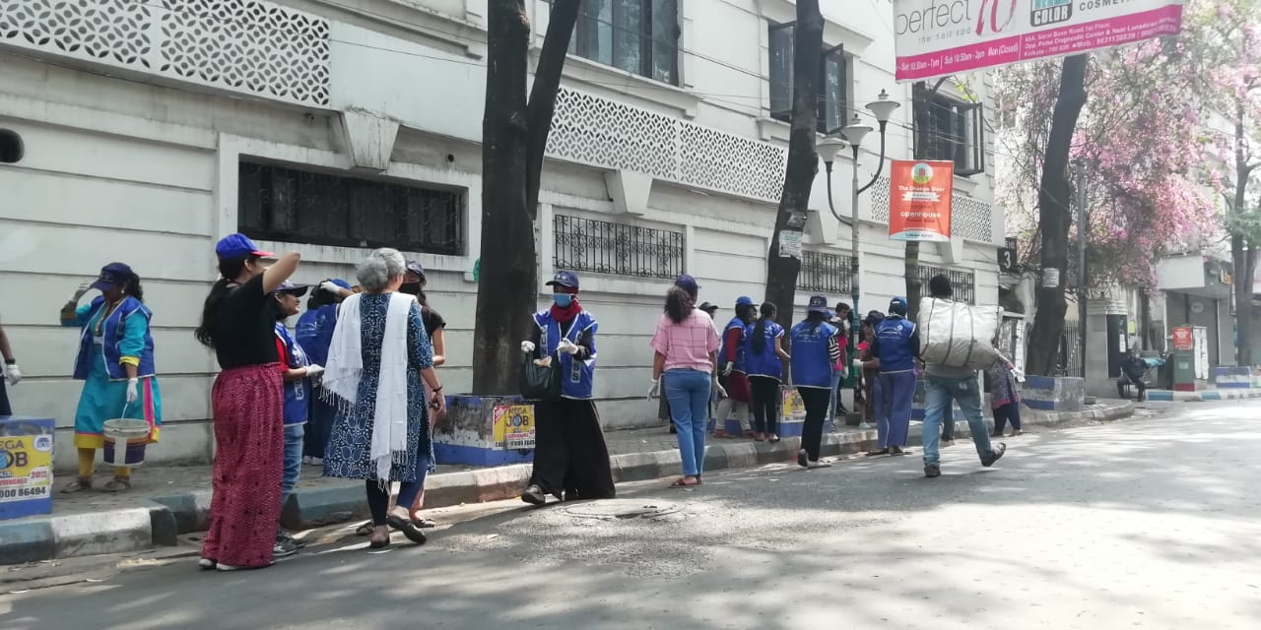
SPECIAL CAMP-2020

Slide 12
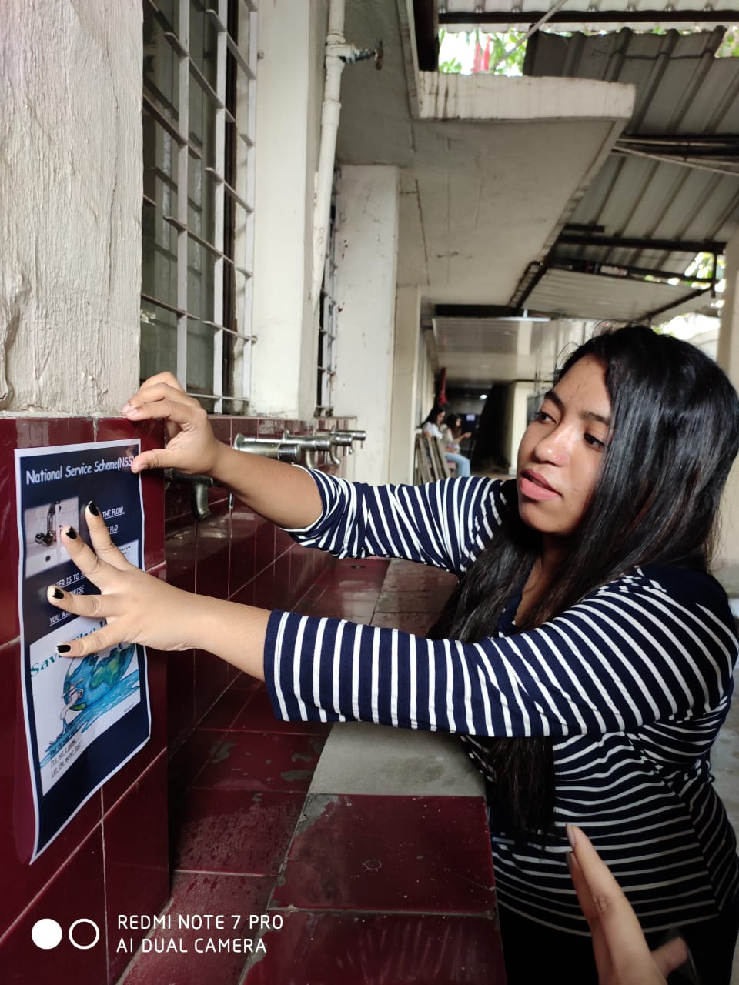
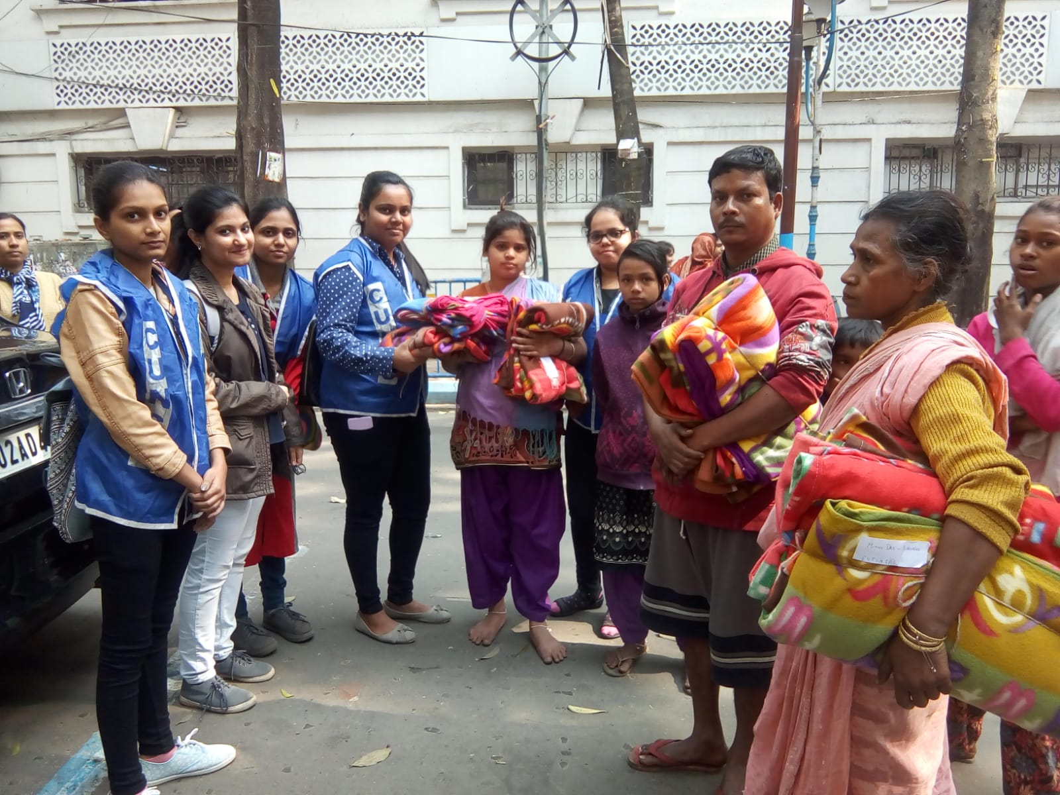
OTHER WORK

Slide 13
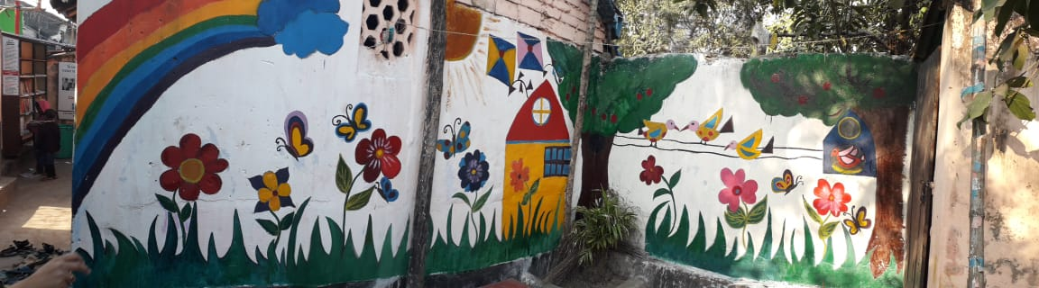
SPECIAL CAMP-2019

Slide 14
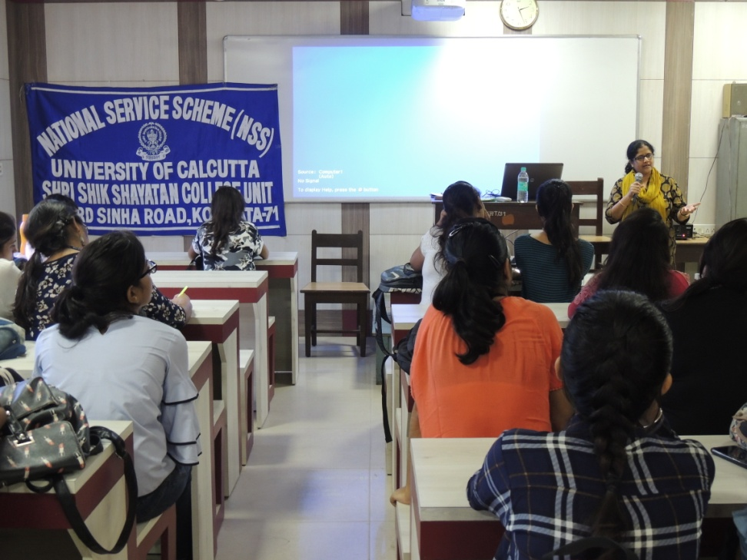
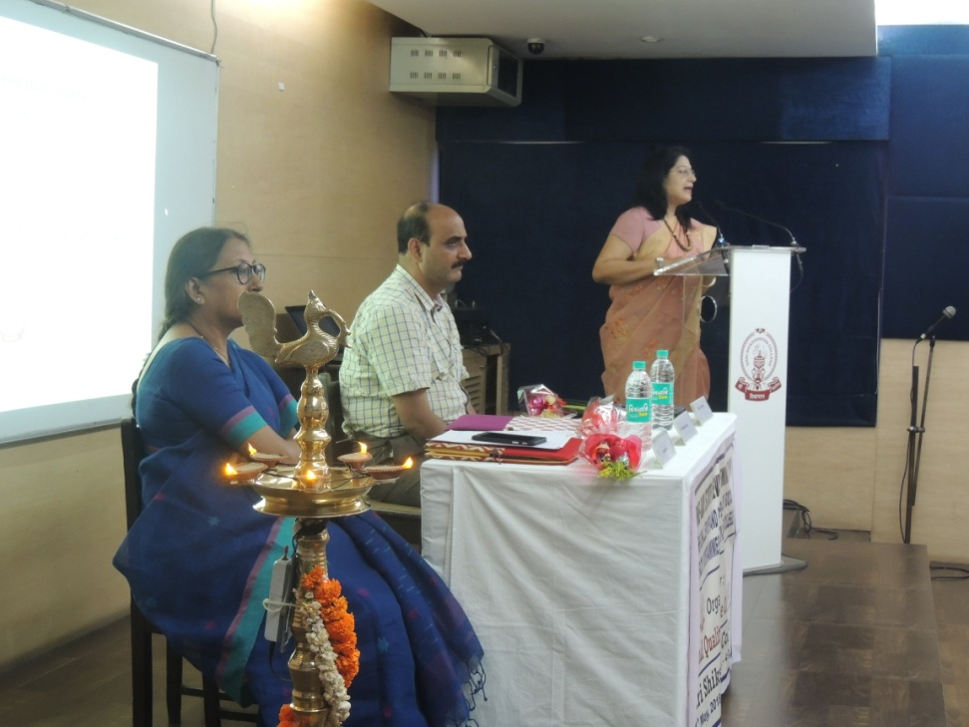
AWARENESS PROGRAMMES

Slide 15
WHAT YOU NEED TO DO
REGISTER BY FILLING UP A GOOGLE FORM WHOSE LINK IS ALSO GIVEN IN THE CHAT BOX
https://forms.gle/2sbnFb6dcBNqFmQy5
JOIN THE WHATSAPP GROUP NAMED: NSS GROUP 2
https://chat.whatsapp.com/Jj3L6B9XnhFBu0XfnaHlH5
I WILL BE POSTING ABOUT VARIOUS ACTIVITIES, PLEASE RESPOND IN THE GROUP.
ATTENDANCE FOR MISSED CLASSES ARE GIVEN, WHEN YOU PARTICIPATE IN NSS ACTIVITIES.

Slide 16
SPECIAL CONSIDERATIONS FOR COVID
MOST WORK WILL BE ONLINE
FOR OFFLINE WORK PARENTAL CONSENT LETTER NEEDS TO BE SUBMITTED (shikshayatannss@gmail.com)

Slide 17
FORMAT FOR PARENTAL CONSENT LETTER
I am aware that my daughter ……………………., of ……………………………..department is going
to ………………………. for NSS activity. I have no objection to it.
Signature
(Father/Mother of ………………….)

Slide 18
WORK THAT YOU CAN DO AT HOME
MAKE CLOTH MASKS OR CLOTH BAGS AND GIVE TO PEOPLE WHO NEED IT
FEED STREET DOGS/CATS
DONATE BOOKS/GROCERIES TO NEEDY
DONATE OLD SMART PHONES TO SCHOOL GOING KIDS WHO NEED IT BUT CAN’T AFFORD (AFTER PROPERLY ERASING ALL DATA)
SPEND TIME WITH ELDERLY PEOPLE
PLANT TREES

Slide 19
IMPORTANT!!!
ORIENTATION SEMINAR BY BLODCONNECT ON 4TH FEBRUARY ON HOW WE CAN HELP THEM ONLINE.
15TH TO 22ND FEBRUARY –SPECIAL CAMP COMING UP. (VIRTUAL, FOR 2 HOURS EVERY DAY)

